Slide 1

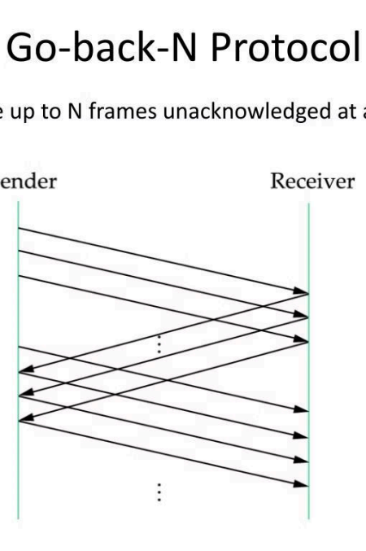
Reliable File Transfer using Go-Back-N Protocol
Student Name: 刘东洋 (Liu Dongyang)
Course Name: Computer Networks 2023-2024-2
Instructor: 阮思捷
1/25

Slide 2

Project Overview
Reliable File Transfer
The project focuses on
implementing a reliable file transfer system between two hosts, Host1 and Host2,
using the Go-Back-N (GBN) protocol.
Effective for
Unreliable Networks
This approach is chosen for its effectiveness in managing reliable data transfer over
unreliable networks, which is a common scenario in real-
world network
communications.
Addressing Real-
World Challenges
The project aims to tackle the challenges of reliable data transmission in real-
world network
environments.
2/25

Slide 3
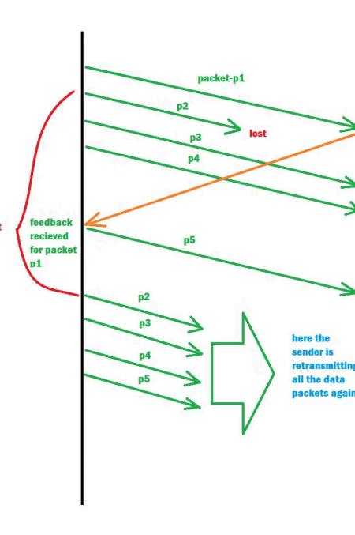
Go-Back-N Protocol
The Go-Back-N protocol is a sliding window protocol that allows for efficient
data transmission by sending multiple frames before needing an acknowledgment for the first frame.
- Reliability: GBN ensures reliability by using acknowledgments for frames sent. If a frame's acknowledgment is not received within a timeout period, all frames from the unacknowledged frame onwards are retransmitted.
- Order and Integrity: It maintains the order of frames and ensures data integrity using sequence numbers and checksums, respectively. If frames arrive out of order or are damaged, the protocol detects this and takes
necessary corrective actions.
3/25

Slide 4
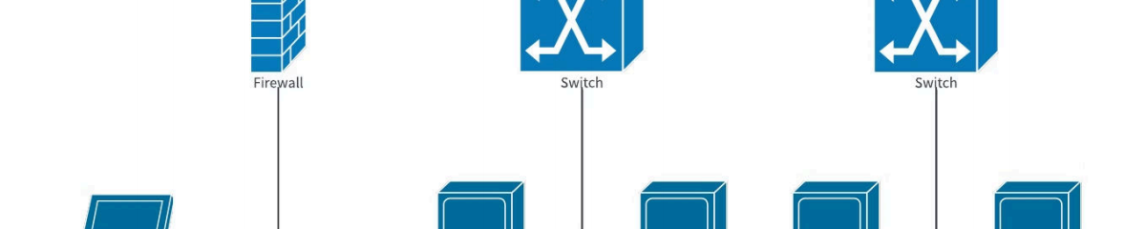
Technical Challenges
1. Frame Structure: Each Protocol Data Unit (PDU) frame in GBN must include a sequence number and a checksum. The checksum, implemented using the CRC-CCITT standard, ensures the integrity of the data by detecting errors that occur during transmission.
2. UDP Socket API: The project uses the UDP protocol for sending and receiving PDUs. UDP is chosen due to its simplicity and lower overhead compared to TCP. While UDP does not guarantee delivery, the GBN protocol implemented on top of UDP handles the reliability aspect.
3. Configuration and Customization: The system allows for adjusting various parameters via a
configuration file, including UDP ports, PDU size, error rates, loss rates, timeout values, and window size. This flexibility helps in testing the system under different network conditions.
4/25

Slide 5
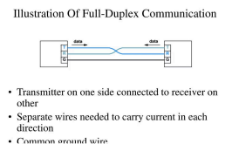
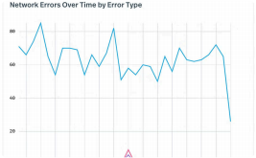
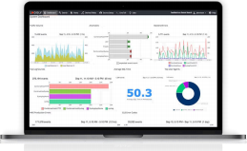
Technical Challenges
Full-Duplex
Transmission
The GBN protocol supports full- duplex operation, allowing both hosts to send and receive files simultaneously, mirroring real- world scenarios where
communication is bidirectional.
Error Simulation
To test the robustness of the GBN implementation, the system can simulate errors and packet
losses. This feature is vital for ensuring the system can handle adverse conditions and still
maintain data integrity and order.
Logging and Analysis
Every transmission event is
logged, capturing details about sent and received PDUs, their
sequence numbers, and statuses.
This data is crucial for
troubleshooting and
performance analysis, allowing for a detailed inspection of the protocol's behavior under
various conditions.
5/25

Slide 6


Design and Structure
Protocol Data Unit (PDU)
Composition
Each Protocol Data Unit (PDU) frame in GBN must include a sequence number and a checksum. The checksum, implemented using the CRC-CCITT
standard, ensures the integrity of the data by
detecting errors that occur during transmission.
Flow Control with Sliding Windows
The Go-Back-N protocol is a sliding window
protocol that allows for efficient data transmission by sending multiple frames before needing an
acknowledgment for the first frame.
6/25

Slide 7


Design and Structure
Sequence Number Management
The system maintains the order of frames and
ensures data integrity using sequence numbers and checksums, respectively. If frames arrive out of
order or are damaged, the protocol detects this and takes necessary corrective actions.
Acknowledgment Handling
The GBN protocol ensures reliability by using
acknowledgments for frames sent. If a frame's
acknowledgment is not received within a timeout period, all frames from the unacknowledged frame onwards are retransmitted.
7/25

Slide 8
Implementation Insights
Languages: Python 3.8
Libraries: Seaborn 0.11.2, matplotlib 3.4.3, numpy 1.21.2, pandas 1.3.5, csv, configparser, socket, threading, time, random, math.
OS: Windows 10
IDE: PyCharm
8/25

Slide 9
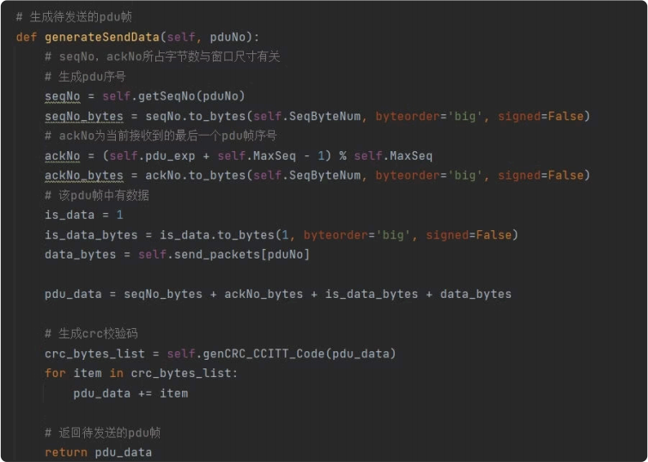
Implementation Insights
Generate PDU
Samples of how the system generates Protocol Data Unit (PDU) frames are provided. The PDU composition includes essential elements like sequence numbers and checksums to ensure reliability and integrity during data transmission.
9/25

Slide 10
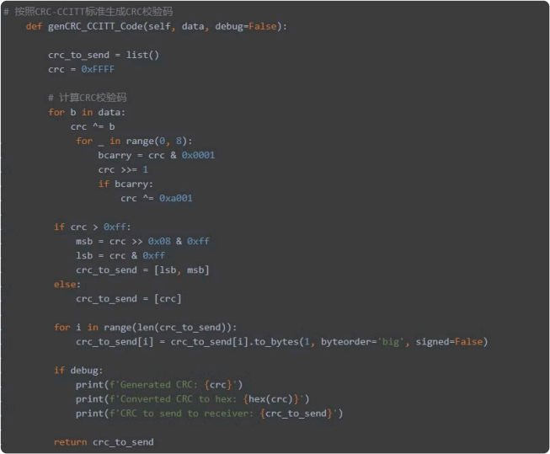
Implementation Insights
CRC-CCITT:
The CRC-CCITT (Cyclic Redundancy Check) algorithm is utilized to implement the checksum functionality within the PDU frames. This helps detect and correct errors that may occur during the transmission process.
10/25

Slide 11
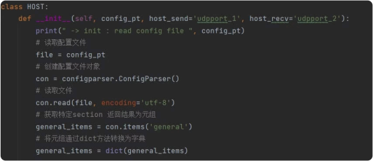
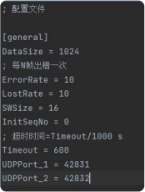
System Deployment
To effectively deploy and utilize the system, two separate Python scripts are crafted, each representing a distinct network host.
Each script utilizes the core host module by incorporating an import statement (import host) at the
beginning of the file. Within these scripts, a specific class is instantiated from the host module, and is then initialized with relevant parameters such as configuration file paths. These parameters define the
operational settings for each host, such as the ports for sending and receiving data which correspond to host_send and host_recv as specified in the configuration file.
11/25

Slide 12
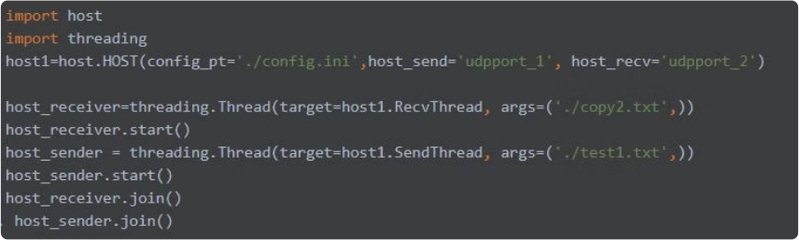
System Deployment
In practical terms, the deployment involves setting up the send and receive paths within each host instance. The parameters for these paths dictate where files should be sent from and received to.
Below is a conceptual example that illustrates how to configure and initiate each host:
12/25

Slide 13
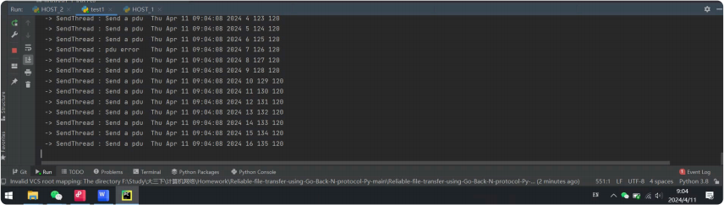
Testing and Validation
From the screenshot showing sending PDUs (Protocol Data Units), the process is mostly consistent without any visible errors. Each line shows a PDU being sent with a timestamp, indicating a steady stream of data transmission.
13/25

Slide 14
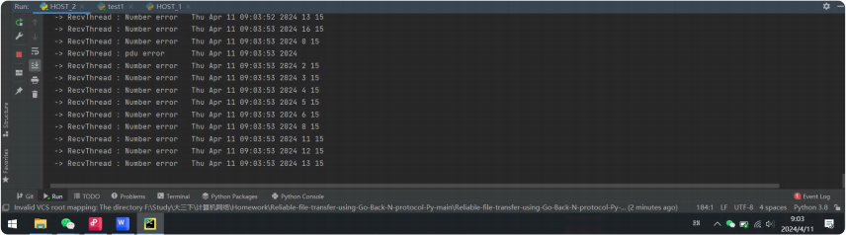
Testing and Validation
The second screenshot, however, shows repeated "Number error" entries during the receiving process. This suggests there is an issue with the sequencing of received PDUs, it means that we succeed in implementing a generator or method that allows random generation of PDU, errors and PDU loss based on the percentage (n%) given in the configuration file.
14/25

Slide 15
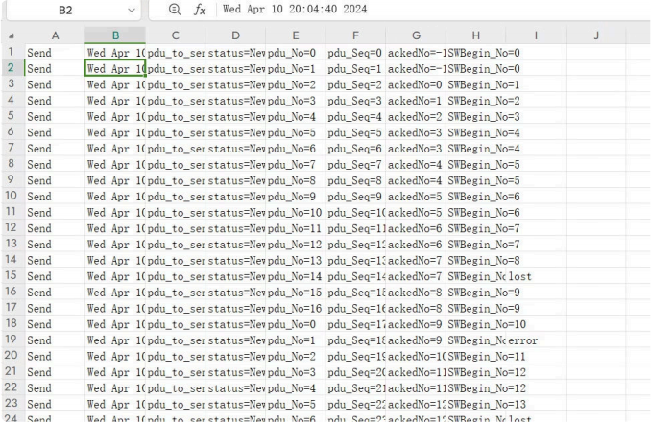
Results and Analysis
We use Analyzing logs.py to analyze the log file and generate the HotMap.
15/25

Slide 16
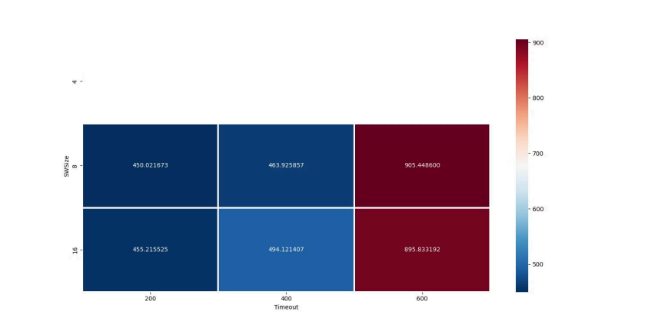
Results and Analysis
Efficiency Heatmap Analysis
The heatmap (Figure 1) presents a comparative view of efficiency across different configurations. The x-axis represents Timeout values, while the y-axis represents SWSize. The color intensity indicates the relative
efficiency, with deeper blues signifying higher efficiency and darker reds indicating lower efficiency.
16/25

Slide 17
Results and Analysis
Observations:
For a timeout setting of 200ms, the efficiency remains relatively high for both SWSize of 8 and 16, with a slight advantage observed at SWSize 16.
Increasing the timeout to 400ms shows a modest increase in efficiency for SWSize 16, whereas there is a slight decrease in efficiency for SWSize 8.
At a timeout setting of 600ms, there is a marked decrease in efficiency for both SWSize configurations, particularly for SWSize 16.
17/25

Slide 18
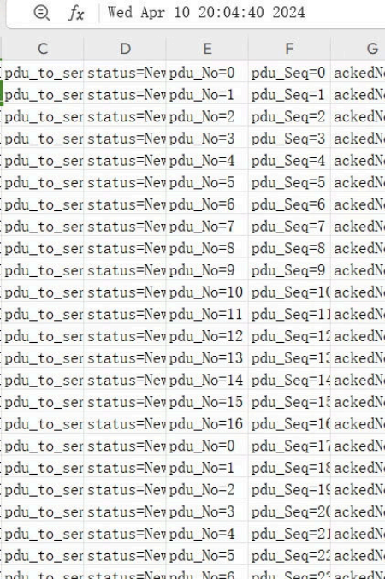
Results and Analysis
Log File Data Correlation
Correlating these findings with the data from the log files (42831_log.csv), we noticed the following:
1. A moderate SWSize of 16 and a lower timeout threshold of 200ms yield high efficiency, suggesting the protocol's capability to promptly address packet loss or errors while maintaining a high data throughput.
2. With increasing timeout values, efficiency diminishes, especially for larger SWSize. This may be attributed to a delayed response in error recovery, adversely affecting overall transmission efficiency.
3. Neither too large nor too small SWSize proved optimal for efficiency enhancement. A mid-range SWSize likely strikes a balance between transmission stability and avoiding unnecessary delays.
18/25

Slide 19
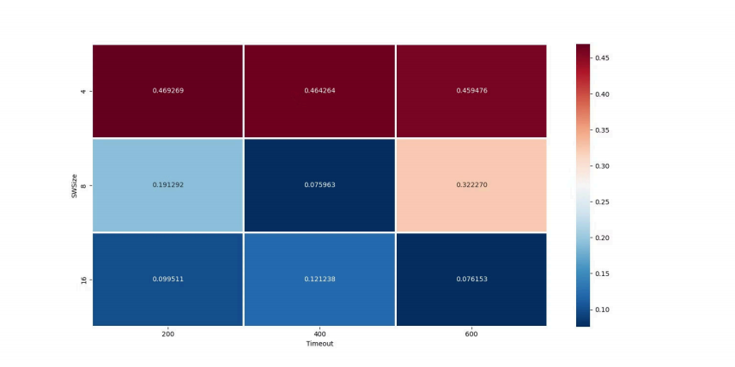
Results and Analysis
Efficiency Heatmap Analysis
The second heatmap (Figure 2) shows the error rates as determined from the receiver's log data. Here, the x-axis represents different Timeout values, and the y-axis shows different sliding window sizes (SWSize). The color gradient represents the error rate, with darker red indicating a higher error rate and darker blue indicating a lower error rate.
19/25

Slide 20
Results and Analysis
Observations:
At a SWSize of 8 and a timeout of 200ms, we see a relatively low error rate (0.191292), suggesting that the protocol is able to efficiently manage errors with a smaller window size and quicker timeout.
When the timeout increases to 400ms, there's a decrease in error rate (0.075963), possibly due to the system having more time to correct errors, but the rate is still low, indicating effective error handling.
With a further increased timeout of 600ms, the error rate increases to 0.322270, indicating that a higher timeout may lead to delays in error detection and correction.
20/25

Slide 21
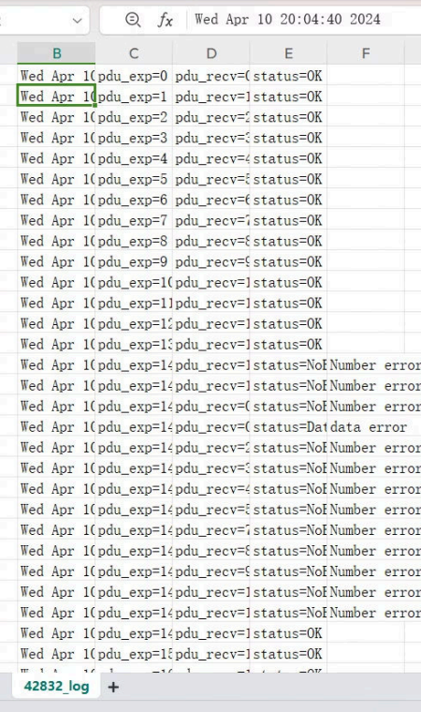
Results and Analysis
Correlation with Receiver Log Data
Considering the receiver log data (42832_log.csv), the lower error rates are
likely due to effective packet management and error correction mechanisms.
As the SWSize increases to 16:
1.The error rate for a 200ms timeout is moderately low (0.099511), but not as low as with SWSize 8.
2.For timeout settings of 400ms and 600ms, the error rate increases
(0.121238 and 0.076153, respectively), which may indicate that larger
window sizes combined with longer timeouts result in less effective error correction.
Based on the analysis of error rates from the heatmap, we can infer that an SWSize of 8 with a timeout of 400ms provides a good balance between error rate and protocol efficiency for the tested network conditions. It allows the system to maintain a low error rate while ensuring prompt error correction.
21/25

Slide 22
Summary and Conclusions
The primary objective of the programming project was to ensure the accurate transmission of large files between Host1 and Host2 over an unreliable network emulated by UDP sockets.
I defined a custom Packet Data Unit (PDU) structure with an appended checksum field utilizing the CRC- CCITT standard, encapsulated within each UDP datagram. By excluding frame delimiters, we simplified the frame structure to focus on the core functionalities of the GBN protocol.
The results were promising, demonstrating the reliability and robustness of the system. The GBN protocol effectively managed the communication, maintaining data integrity where the received file was an exact replica of the original.
Some of the key features of the implemented system included:
- Full-duplex transmission, allowing simultaneous bi-directional data transfer.
- A generator for inducing PDU errors and losses, simulating real-world network unreliability.
- Log file generation for each file transfer, enabling detailed post-transfer analysis.
22/25

Slide 23

Summary and Conclusions
In conclusion, the system met the goals of reliable file transfer over an unreliable medium using the GBN protocol. It demonstrated the ability to adaptively manage network inconsistencies while ensuring the integrity and accuracy of the data transferred.
Future enhancements may include support for multi-host file transfers and the exploration of concurrent file transmissions through the application of multi-threading or queueing techniques.
23/25

Slide 24

References
Tanenbaum, A.S., & Wetherall, D. J. (2010). Computer Networks (5th ed.). Prentice Hall. Essential reference for the Go-Back-N protocol and network concepts.
Forouzan, B. A. (2002). Data Communications and Networking (2nd ed.). McGraw-Hill. Supplementary materials on error detection and correction techniques.
Stevens, W. R. (1994). TCP/IP Illustrated, Volume 1: The Protocols. Addison- Wesley. Reference for socket programming and UDP protocol.
Postel, J. (1980). RFC 768: User Datagram Protocol. Internet Engineering Task Force. Official specification of the UDP protocol.
Kurose, J. F., & Ross, K. W. (2010). Computer Networking: A Top-Down Approach (5th ed.). Pearson Education. Additional insights into network protocol design and performance analysis.
24/25

Slide 25

Comments
This course and the associated project on reliable file transfer using the Go-Back-N protocol have provided a hands-on experience that bridged theoretical networking concepts with practical application. The project
facilitated a deeper understanding of network protocols, error management, and performance optimization.
Suggestions:
Course Material: We need a more detailed experimental tutorial and guidance materials.
25/25

